Slide 1

PCMA JOINT DESIGN
Date: 07 August 2026
Photo by Stefan Els
Notes:
Co-branded Cover Slide Option
Replace the background image: Right-click on the slide, then choose Format Background and select Picture or texture fill. Select a new picture of your choice.
Remember to add an image attribution for e.g., Photo by Stefan Els.

Slide 2
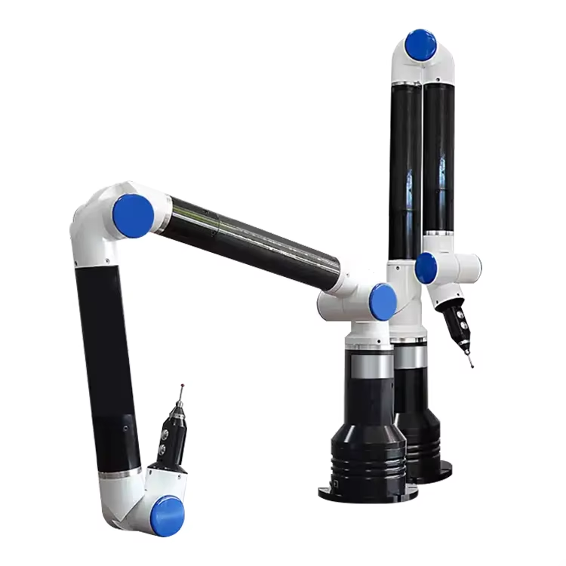
Introduction
Background
PCMA – Portable coordinate measurement arm
Hand-held metrology instrument used to capture 3-D coordinates directly from a physical object
Manual operation introduces positional instability during calibration and utilisation
Joint design with position-holding implementation would:
Improve PCMA stability
Improve kinematic stability and accuracy
A good practice of safety

Slide 3
Introduction
Aim
Generalise the Denavit-Hartenberg (D-H) model derived by Prof. Schreve and Mr. Hall
Design, build, and test key components of the joint to assess the joint design’s mechanical feasibility
To integrate the test results and into the D-H model and assess feasibility of the joint design
Scope
Limited to designing, building and testing key components

Slide 4
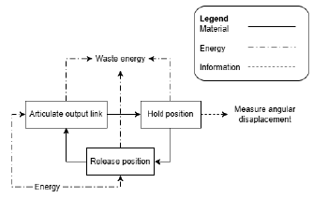
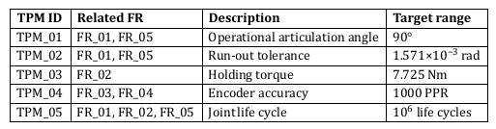
Requirement Analysis
Stakeholders were identified and categorised
System concept was defined in which NSoI and WSoI were identified
Design independent parameters were defined
Functional Requirements
Technical Performance Measures

Slide 5
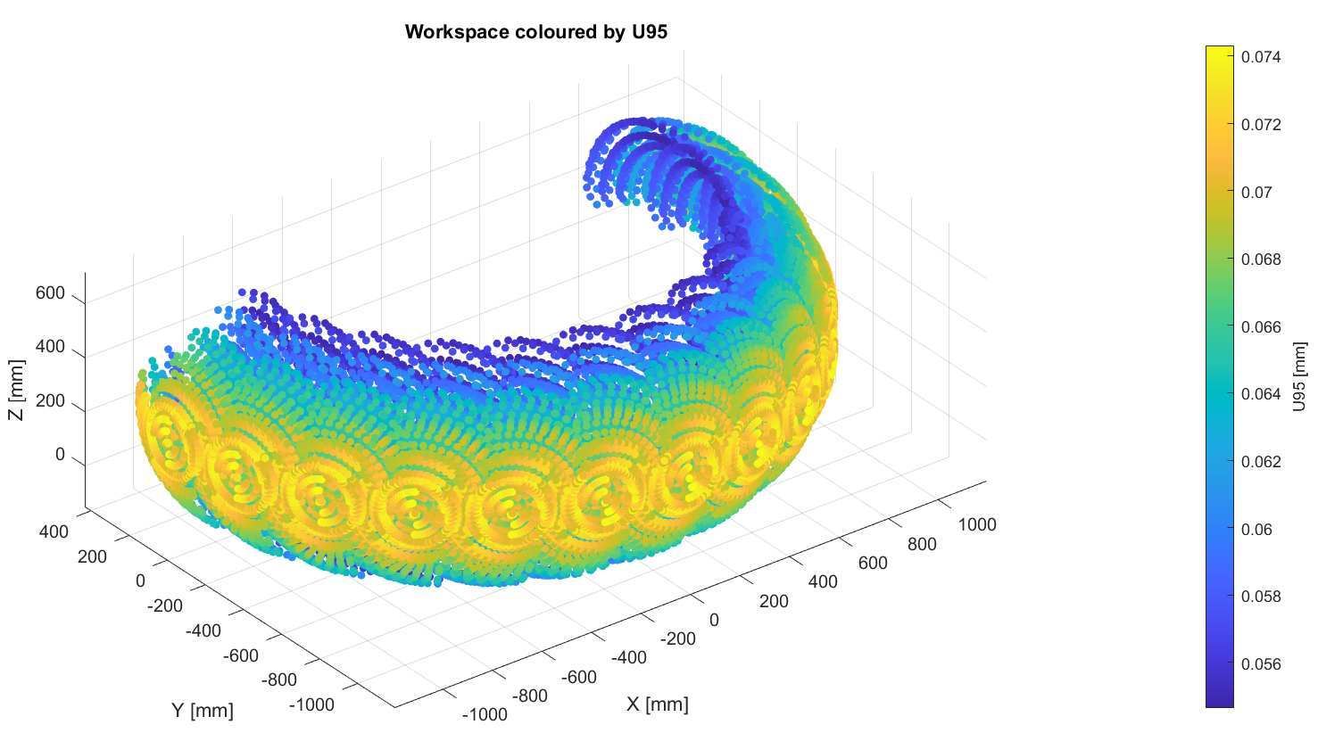
Requirement Analysis
TPM Derivation – D-H Model
Generalised D-H model samples workspace and determines uncertainty in workspace
Worst-case uncertainty value of 0.0743 was determined
Uncertainty value was used to scale target encoder uncertainty (50 microns)
Encoder uncertainty was used to calculate encoder resolution of ~80 000 PPR
Encoder resolution was used to calculate shaft radius of ~19 mm
Shaft radius was used to calculate run-out tolerance of ~1.449 microns

Slide 6
Requirement Analysis
TPM Derivation – Market availability and Cost Constraints
Only an encoder of 1000 PPR was attainable
Encoder resolution was used to calculate shaft radius of ~9 mm
Shaft radius was used to calculate run-out tolerance of ~13.71 microns
Rest of TPM derivations were identical based of off link mass
Assumed link mass is 1.5 kg
With safety factor of 1.5, holding torque was calculated to be 7.725 Nm

Slide 7
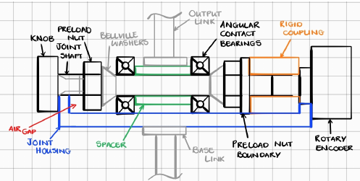
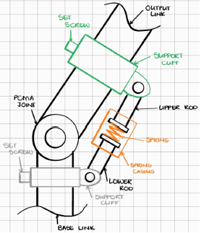
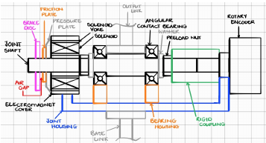
Concept Development
Locking Dial
Counterbalance Spring
Electromagnetic Brake

Slide 8
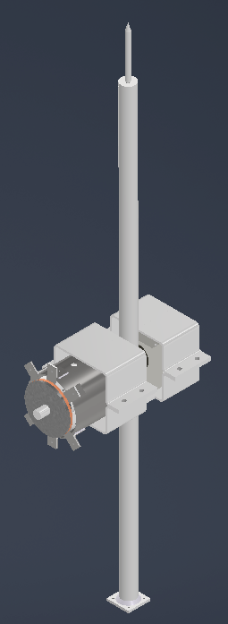
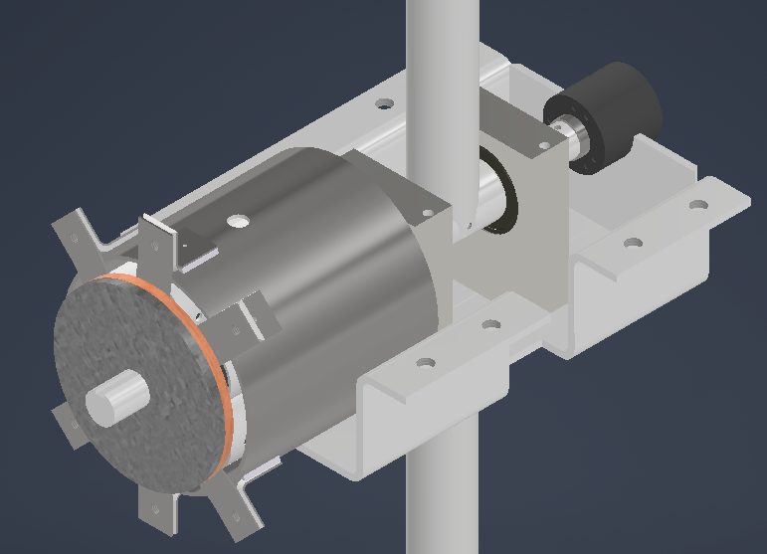
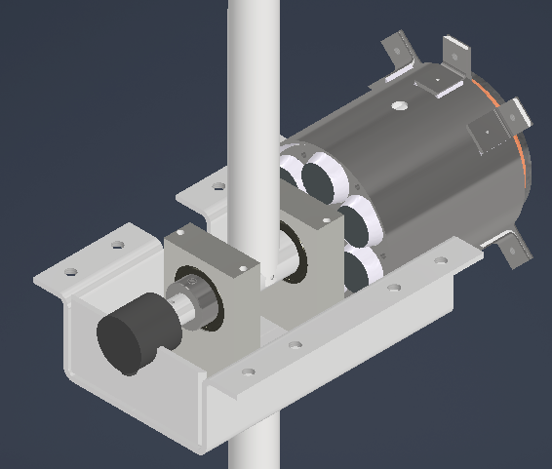
Concept Development
Chosen Concept: Electromagnetic Brake
Best capability for position-holding implementation
Does not inhibit the joint’s range motion
Design is integrated with joint shaft
Provides the best positional stability

Slide 9
What’s Next
Manufacturing of key joint components
Experimentation
Testing key joint components
Documentation of experimentation results and findings
Further documentation of final report and presentation

Slide 10

Thank you
Enkosi
Dankie
Photo by Stefan Els
Notes:
Co-branded End Slide Option
Replace the background image: Right-click on the slide, then choose Format Background and select Picture or texture fill. Select a new picture of your choice.
Remember to add an image attribution for e.g., Photo by Stefan Els.

